Slide 1


US Accidents Analysis
Business Part

Slide 2
Team 14
Ahmed asaad darwish mohamed | 1 | 1
Mamdouh ahmed Mohamed attia | 2 | 26
Omar fareed Abdel-Aaty | 2 | 6
Mohamed Nabil Abd-Alfattah | 2 | 19

Slide 3
TABLE OF CONTENTS
01
02
03
Introduction
Problem Description
Proposed Solution
04
Value Proposition
Project Overview
Target Audience
•Road safety importance
•US Accidents Dataset
•Our approaches and goals
•Used tools & techs.
Our project Insights impact on road safety

Slide 4
01 Introduction
Project Overview
Target Audience

Slide 5
Project Overview
In this project, we leverage Big Data Analytics to gain insights from a large dataset of US accidents obtained from Kaggle.
Our goal is to understand the underlying factors that contribute to accidents and ultimately make roads safer.

Slide 6
Target Audience
This project's findings can be valuable to various stakeholders:
Government Officials: By identifying high-risk areas and accident patterns, they can implement targeted safety measures (e.g., improve road infrastructure, enforce traffic regulations).
Transportation Departments: They can utilize the insights to optimize traffic flow, prioritize maintenance efforts, and develop public awareness campaigns.
Drivers: Understanding accident trends and weather-related risks can empower them to make informed decisions and adopt safer driving habits.

Slide 7
02 Problem Description
•Road safety importance
•US Accidents Dataset

Slide 8
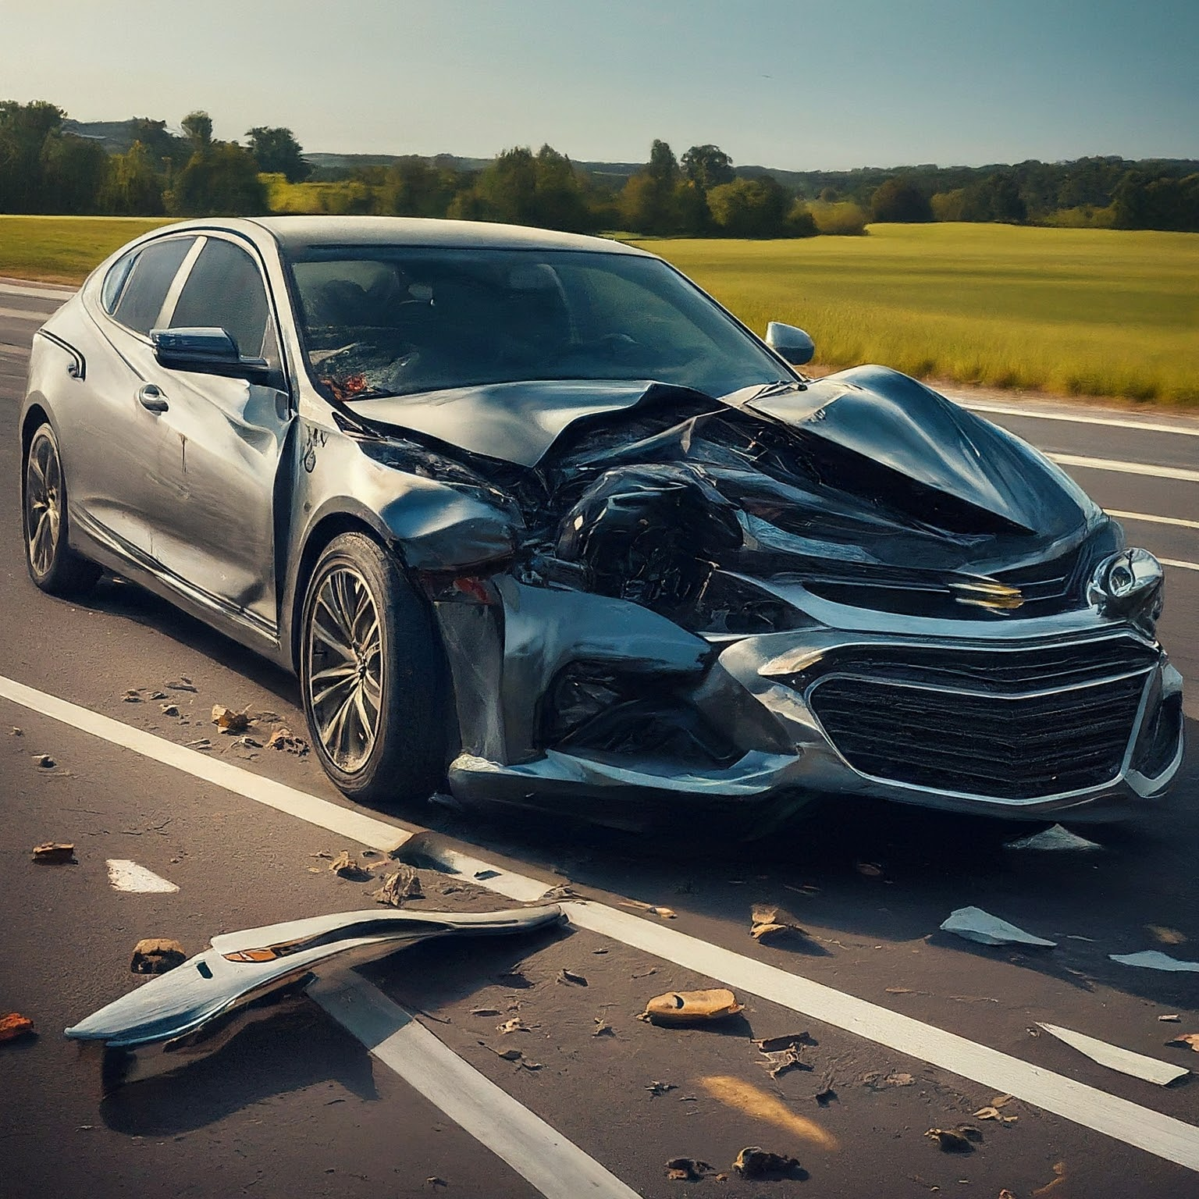
The Urgency of Road Safety
Road accidents are a significant global problem, causing:
Loss of life and injuries: Every year, millions are affected by road accidents
Economic burden: Accidents incur immense costs for individuals, families, and healthcare systems.
Emotional trauma: Accidents can have a lasting emotional impact on victims and their loved ones.

Slide 9

Equip Big data !
To address these issues, we need to understand the factors contributing to accidents.
We leverage Big Data Analytics to analyze a comprehensive dataset of US accidents
from Kaggle.
Dataset link:
https://www.kaggle.com/datasets/sobhanmoosavi/us-accidents/data

Slide 10
About the US Accidents Dataset
This dataset provides a rich source of information on accidents across the United States.
Key characteristics:
Size: Approximately 7.7 million records [ BIG ]
Features: overall 49 columns : Includes details like location, time, weather conditions, and accident severity
By analyzing this data, we can uncover hidden patterns and gain valuable insights!

Slide 11
How ???
After analyzing the relation between the factors, measures can be taken like:
For High severity locations, can add rescue units/ First aid .
The specialized authorities can raise awareness for people about dangers of accidents and dangerous weather conditions/places/POIs (e.g. crossing) referring to the insights extracted from the analytics.
Streets maintenance at the high risk locations with more severe factors….
And more…

Slide 12
03 Proposed Solution
•Our approaches and goals
•Used tools & techs.

Slide 13
Approaches and Goals
Framework: PySpark
Cloud : GCP.
Exploratory Data Analysis (EDA) Phase Steps:
Understanding variables
Data cleansing (e.g., check nulls, default values)
Dropping unwanted columns
Visualization

Slide 14
Approaches and Goals
Insights Gain:
Analyzing the relationship between weather conditions and accident severity
Rate of accidents in cities
Map plot of accident severity in the US
Predictive analytics:
Predict class severity w.r.t important factors
Descriptive analytics:
Cluster the locations of the accidents

Slide 15
04 Gained insights & results
• Summary of our EDA findings

Slide 16
Gained Insights summary
The dataset only includes data for 49 states.
Miami has the highest number of reported accidents.
The frequency of accidents per city follows an exponential decrease pattern.
Only 13.5% of cities have more accidents than the average.
Accidents are most common between 8 am to 10 am and 3 pm to 6 pm, suggesting a higher likelihood during peak commuting hours.

Slide 17
Gained Insights summary
6. Weekdays show a higher number of accidents compared to weekends.
7. The year 2023 has the lowest number of reported accidents, likely due to data availability only until March 2023.
8. Coastal areas experience higher accident rates compared to inland regions.
9. The top 10 most frequent weather conditions for accidents are: Fair, Mostly Cloudy, Cloudy, Clear, Partly Cloudy, Overcast, Light Rain, Scattered Clouds, Light Snow, and Fog

Slide 18
Gained Insights summary
10. Analyzing the relationship between weather conditions and accident severity revealed the following insights:
Light Blowing Snow has the highest average severity at 3.67.
Patches of Fog / Windy, Heavy Freezing Rain / Windy, and Light Fog have average severities of 3.14, 3.00, and 3.00, respectively.
Partial Fog / Windy, Heavy Thunderstorms and Snow, Light Thunderstorms and Snow, Heavy Ice Pellets, Heavy Blowing Snow, and Drifting Snow / Windy also show significant average severity levels.

Slide 19
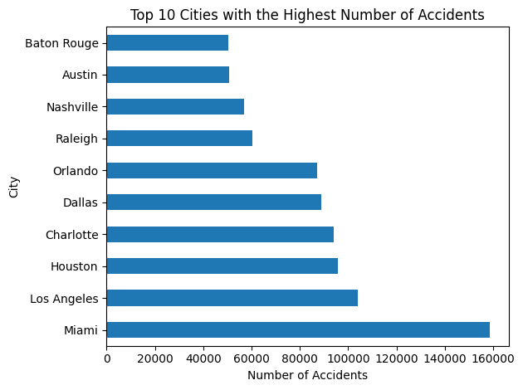
Visualization

Slide 20
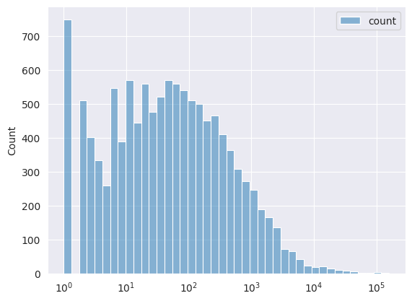
Visualization: #accidents

Slide 21
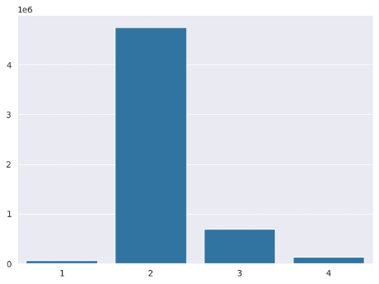
Class severity values

Slide 22
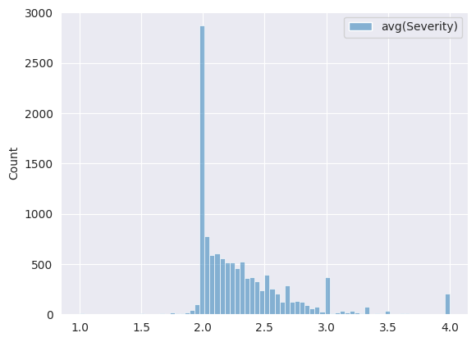
Average severity per city

Slide 23
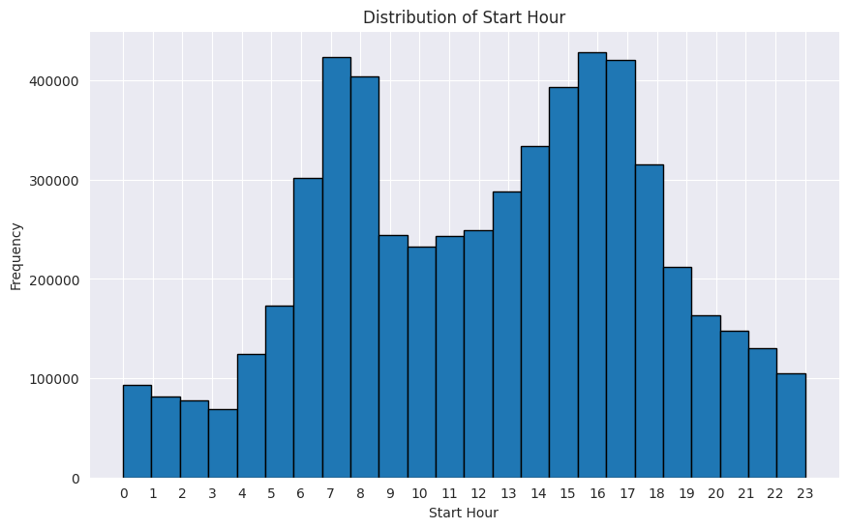
Hour

Slide 24
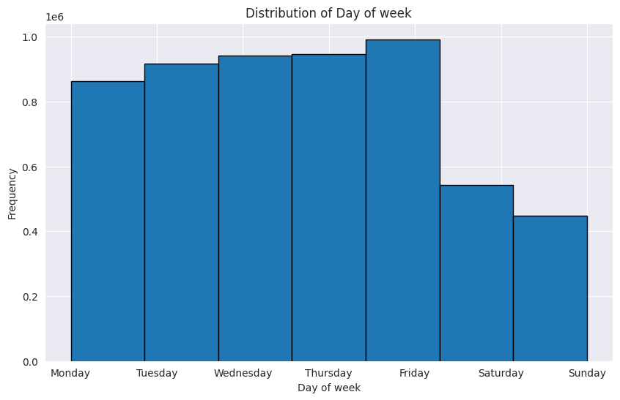
Day

Slide 25
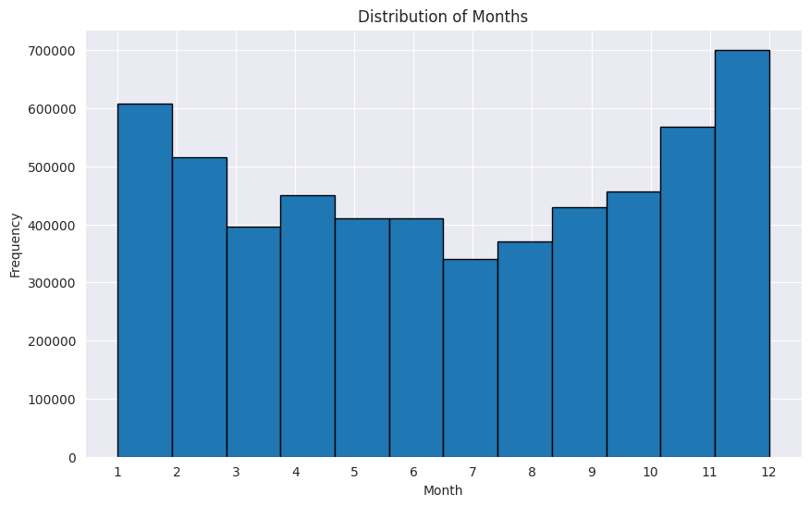
Months

Slide 26
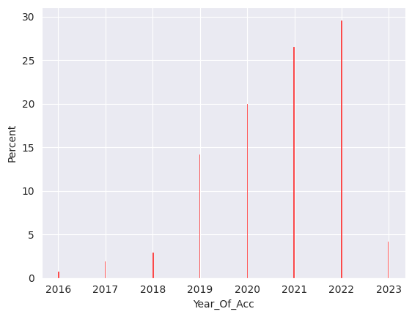
Year

Slide 27
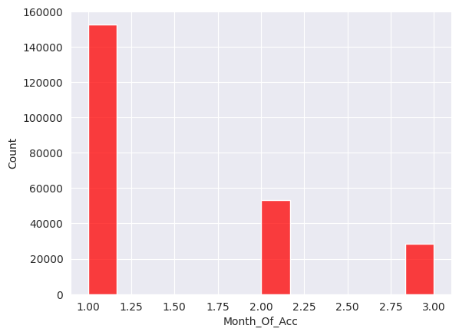
2023 data

Slide 28
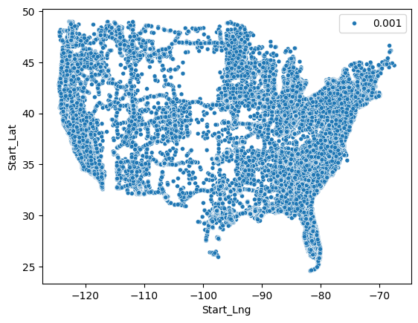
Start Latitude and Start Langitude scatter plot.

Slide 29
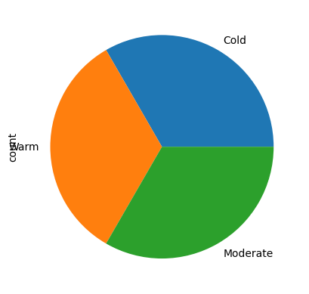
Temperature category

Slide 30
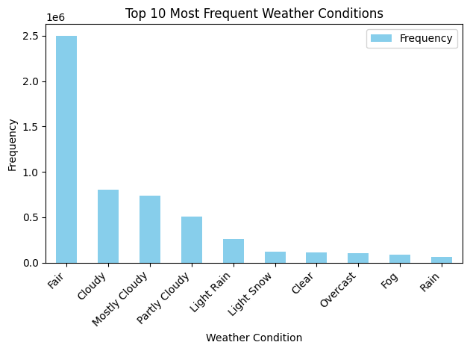
Visualization

Slide 31
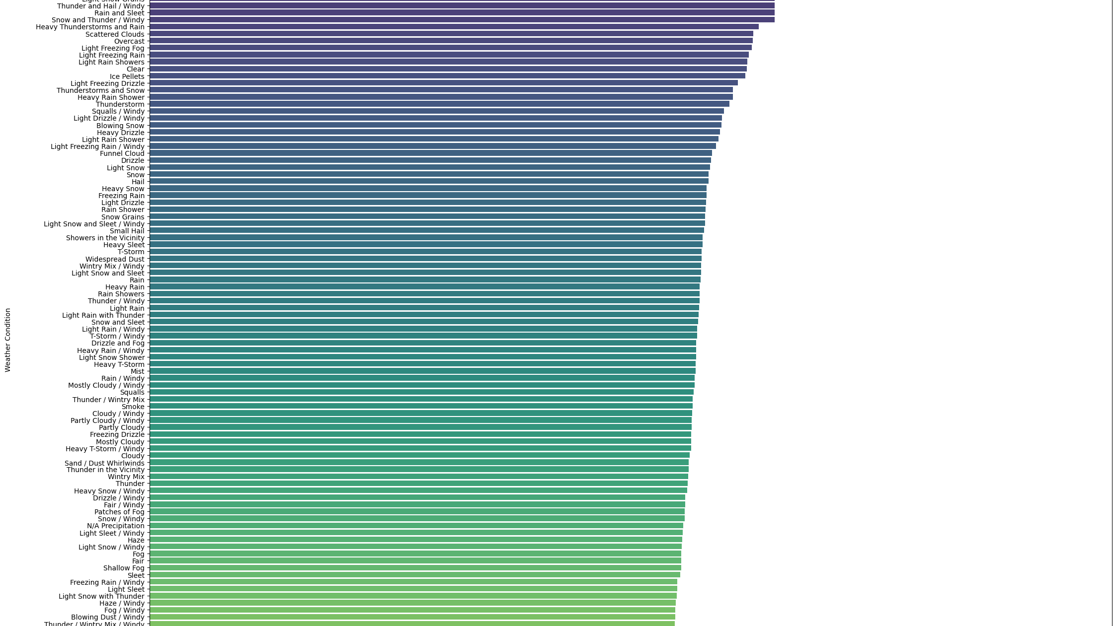
Impact of Weather on Accident Severity
Group data by weather condition and calculate mean severity

Slide 32
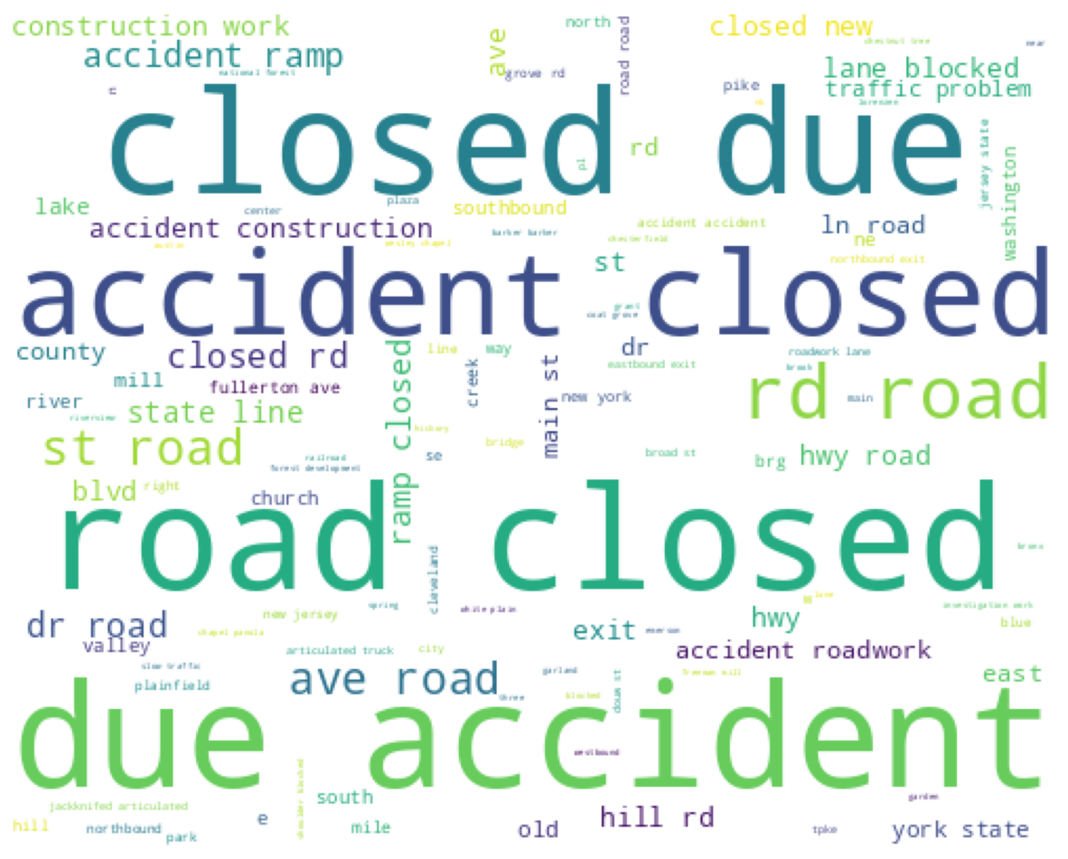
Word Cloud of description column

Slide 33
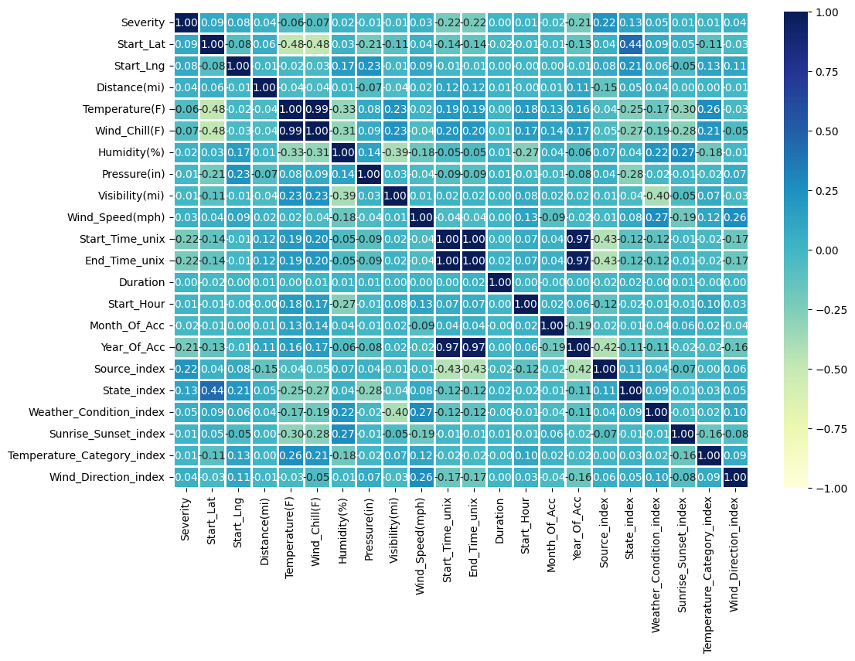
Correlation Matrix

Slide 34
Thank You !
End of Business Part

